Slide 1
API 360 Offerings

Slide 2
API Platform Implementation – Key Tenets
API Platform Implementation & Structuring
API Technical Consulting
API Product & Technology Selection
Current State Assessment and Target State definition
API Platform Setup
API Development & Sustenance
API Data Modelling
API Testing
Domain driven Data Modelling for API
API and Microservices testing, migration validation and testing automation
API Development
API Governance
API Development
Govern, Strategize and Mature API Platform in alignment with business goals
Develop API and Microservices
API Standards and Governance Alignment
API & Microservices Development & Sustenance
API Testing and DevSecOps
Infrastructure
API Management
API Platform and Microservices Deployment Infrastructure
Manage APIs using API Management Tools
API Migration
API Migration Assessment and Cutover Planning
API Code and Configuration Migration
API Validation Testing
DevSecOps
API Program Structuring
CI/CD Implementation, Installation Automation
API Platform Setup or Upgrade
API Topology Definition
API Platform Setup & Sustenance
API Platform Upgrade

Slide 3






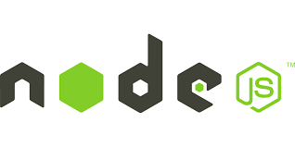








API Overall Capabilities
Consulting/Advisory
Platform & Architecture
API Platform Assessment
API Management Product Selection
API & Microservices Technology selection
Technical Consulting on API Roadmap
API Platform Topology
Microservices Architecture
API Management Architecture
API Design Patterns
Hybrid or Multi-cloud Architecture
Migration
Build/Development
Migrate across API Platforms
API Migration Assessment
Legacy/Monolith Apps to API/Microservices Migration
API and Microservices Development
API Management Proxy Development
API Publishing
API Marketplace
Capabilities
Support/AVM
Validate/Test
API Support and Sustenance
API Platform Support, Maintenance and Upgrade
API Platform Validation
API Performance testing
API Functional testing
Govern
Release/DevOps
API C4E
API Lifecycle and Version Management
API Identification
Process, Best practices and standards setup
DevSecOps for API
API Analytics and Monitoring Dashboard
API Release Management
API Platform Monitoring

Slide 4

API Management Capabilities

Slide 5

API Management Offerings
API Platform Advisory & Consulting
API Platform Updates
API Platform Advisory and Assessment , Implementation roadmap and recommendations.
API Product Installation and configuration, topology definition, Product version and patches upgrades
API Platform Engineering
API Platform Migration Services
API Architecture, Design and Development.
API Program Execution
API Platform migration readiness assessment, Migration Execution and Support
API Developer Experience and Marketplace
API Support and Sustenance
API Developer Portal Implementation, API Marketplace strategy, API Developer Evangelization
API Platform Sustenance , API Product Support Services

Slide 6
API Management Practice Overview
Our Implementations across verticals
API Platform Assessment and Future Roadmap structuring for a retailer. Assessment performed to migrate from Apigee OPDK to Apigee X or Apigee Hybrid with envoy adapter.
API Product Selection, API C4E Setup and Cloud based API Management Solution implementation for a Lifesciences Customer.
iMAX – In-house developed Migration Tool for Apigee X and Apigee Hybrid
Installation of 13-node cluster for API Platform across 2 datacenter for a learning management client.
Migration of 146 APIs from Apigee Edge to Apigee X for a retail customer, with zero down-time customer switchover.
Frameworks, PoVs and Accelerators to facilitate API Management Project implementation
API Gateway implementation on AWS for Unified Loyalty Platform for a large retailer.
Implementation of API Management solution for a datacenter technology provider in Apigee X .
Dedicated Center for Excellence
20+ API Management Professionals
40% Team Certified
8+ Projects executed

Slide 7

Intelliswift Accelerator - iMAX Feature Overview
An intuitive UI based tool, which accelerates, automates and abstract migration of API Proxy code and related configuration from Apigee Edge to Apigee X or Apigee Hybrid.
Apigee Edge
Migration Tool
Download Source Org configurations
Supported Migration Entities
Tools Features
Analyze, Segregate, Modify configurations to migrate per User Input
API Proxy and its revisions
Shared Flow
Target Servers
KVM
API Products
Apps
Developers
Users with RBAC mapping to Google IAM
Custom Reports
User Inputs to Segregate API proxies across multiple environments
Support for Custom Role mapping for Users
User can choose the entities to migrate
Conflict resolution while migrating to existing Apigee X orgs
Pre-migration analysis view
Retry for failed Migration entities
Migrate the configuration to Target org on Apigee X
Apigee X and Apigee Hybrid

Slide 8

Microservices Capabilities

Slide 9

















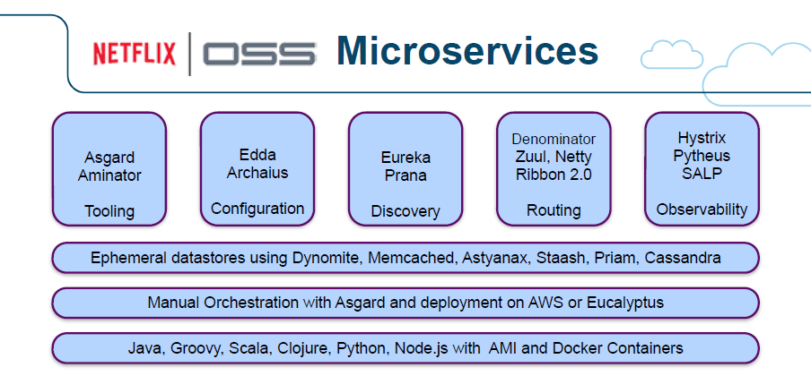




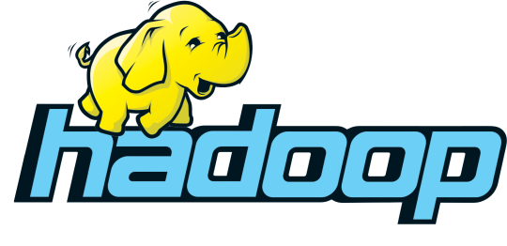
















Microservices Offerings
Microservices Assessment
Build
Complete assessment of enterprise IT systems - Monolith Analysis & Microservices Selection
Microservices Strategy and Architecture
Strategic Roadmap – Drive microservices enablement and adoption
DevOps Lifecycle
Operate
Package
Deploy
Microservices Development – Agile Enterprise
Implement microservices at scale
Cloud Native Development
Dev-Sec-Ops
Digital core, create apps/products, achieve composable architecture
Microservices Migration
Accelerated app modernization; Seamless migration of your monolithic apps and legacy systems to a microservices-based architecture; from SOA to APIs
Microservices Integration
Build and manage microservices effectively by integrating APIs to make application databases and legacy apps for flexibility and agility
Data Microservices – enable data pipelines and service generated insights as APIs

Slide 10
Microservices Expertise
Business Benefits
Microservice Specializations
Agility
Domain Driven Design (DDD) best practices in analysis and design
Java Spring Boot Implementation using
Spring Cloud Frameworks
Spring Data
Spring Cloud Stream
Pattern based microsericves
REST HATEOAS
CQRS
SAGA
PCF configuration for non-functional requirements
Auto-scale
Configuration Service
Monitoring
Resiliency
Blue-green deployment
API driven enterprise
Omni channel support
Biz capability centric services
Independent service delivery
Availability
24*7 availability
Zero downtime with Blue-Green deployment
Canary release to tackle new functionality
Servicing Global Clients for 8+ years
Scalability, Fault Tolerance & Resiliency
Elasticity by Container-as-a-service
Auto-scaling
Service redundancy
Service resiliency on fail-over
40+ Microservices consultants and architects
20+ certified in PCF/ OpenShift/ AWS/ Azure/ GCP
Operations
15+ projects implemented
CI/CD support
Real-time service monitoring & tracing
Real time log visualization
Real time analytics

Slide 11
Microservices Success Stories
Our Implementations across verticals
Re-architected apps and migrated from on-premise to Azure Kubernetes services for an online education and certification program company
Designed and implemented AWS microservices based architecture across multiple integration touchpoints, catering to true omni-channel experience for an equity, risk and compliance mgmt. company
Developed over 40 microservices, with a pre-package set of utilities, deployed in Docker container in Kubernetes, with 30% savings on the TCO for a customer engagement and loyalty programs company
Cloud-Native app on AWS for a real-estate marketplace
Forecasted 100X users and traffic with virtually no limit for scale, >99.9% availability and increased revenue opportunities.
Business stays relevant with Higher SEO score, <2 second page speed, near real time image processing and responsive design.
Digitized portals with 100+ microservices for a Health Benefits Org
Microservices & Tools: Spring Boot, Integration, Hystrix Circuit breaker & NGINX as service/fabric mesh API
Dev Ops: Docker, Docker Swarm, Automation techniques
Monitoring: SPLUNK
Security: APIGEE API
For a financial services system, implemented the below
Intelliswift Solutions Using Microservice Patterns:
Synchronous/ Asynchronous Communication
Service Discovery
Reliability (Circuit Breaker)
Observability; Log Aggregation
Application Metrics; Distributed Tracing
Data Management:
CQRS
Event Sourcing
Distributed Transactions
Authorization / Authentication
Microservices MVP JumpStart
proven patterns, tools, frameworks, ref. implementations & templates, AI-driven automation, deployment packaging & automation

Slide 12

DevOps Capabilities

Slide 13
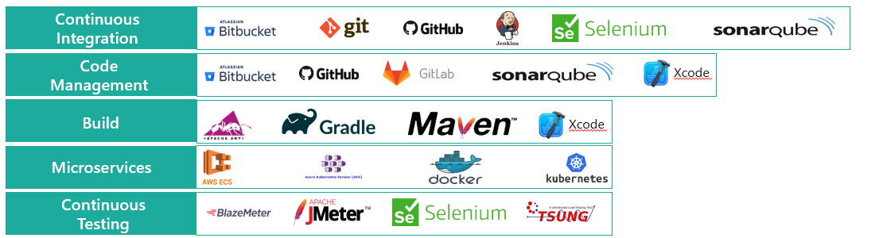
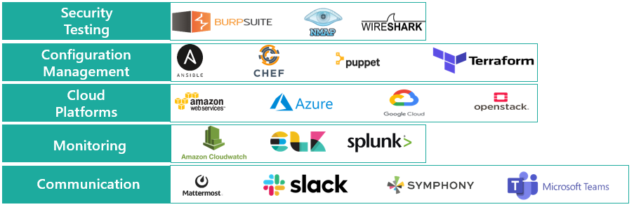
DevOps Offerings
Assessment and Planning
Process Automation
Security Integration
Production
Support
DevOps Assessment Roadmap – Desired state, traceability matrix
Analyze current IT infrastructure, available resources, products portfolio
Automate the process pipeline from code generation, to production, covering builds, test cases, gated quality checks, security, monitoring and continuous feedback
End-to-end security integration through ‘Security-as-Code’ mechanism, Dev-Sec-Ops
24/7 Continuous support to maintain smooth transition of the software infra
Uniform load distribution
Process Implementation – CI/CD Pipeline
Design, implementation, continuous development, continuous integration, continuous testing, and continuous deployment
Containerization Approach – Alignment between CI/CD, IaC and environments

Slide 14
DevOps Practice Overview
Our Implementations across verticals
Enterprise Partner for DevOps strategy – 20+ apps for a leading utilities company;
Enterprise solution design for CloudFormation, Chef, ETL Pentaho – 6TB+ data managed in production
Enterprise Partner for Automated Provisioning and Build Release Management for a leading hospitality company
Complete automation (build deployment, testing) of 40+ applications across 8 different environments
Achieved high code quality for cookbooks using Robocorp
Achieved high maintainability by practicing granularity of Cookbooks
High up-time of production boxes using Chef server administration
Improved time to market, thus releasing critical features in a timely manner to our end users
Standardized deployment tools, process & architecture across the enterprise
Increased productivity of application teams
For a financial services org with 180+ apps, 300+ developers, 400 Test servers, 3000 Production servers, achieved the below –
Daily production deployment with near zero outage; outages down to under 30 mins per month
Improved release velocity – 2 weeks to initiate a new feature to production
Increased team productivity and output
No-Code DevOps Orchestration and Automation Platform
Frameworks, PoVs and Accelerators to facilitate DevOps objectives, target operating model and DevOps adoption
For a fintech firm,
Established fully automated software delivery platform
Enabled self-service capabilities for development teams to continuously build, package, and deploy apps with approval controls mechanism
Reduced costs and accelerated time-to-value by completely eliminating manual BAU and deployment operations
Dedicated Center for Excellence
30+ DevOps engineers
25% certified across the DevOps toolchain
15+ Projects executed

Slide 15

API Testing

Slide 16






API Testing Offerings
API Testing Tools
Automated API Testing
Functional Testing
Automated frameworks for testing the content of message layer and business logic
Unit Testing – functionality of individual APIs
API Negative Testing
End-to-end functionality of API layer
XML, SOAP, REST – run-time error detection; exception and resource leaks
API Documentation Testing
Reliability Testing
Test Framework Development
Load testing - validation of functionality and performance for the system under various levels of user/ transaction load
Security testing - security checks like penetration testing, authentication, encryption, and access control
API Integration Testing – functionality, reliability, NFRs tests
Bespoke Framework Development - Simple API Mocking to Virtualization; Open-source tools like SoapUI, JMeter or enterprise tools – develop a set of static resources
Review API specifications and use case documentation from test perspective
Details test condition and expected results for each test case
Test Case Development
Test Execution & Reporting
Coding of test scenarios, creating sanity check test suites, surveillance test suites
CI/CD integration
Execution of the developed test suites
Dashboards and Real-Time Reporting

Slide 17
API Testing Practice Overview
Our Implementations across verticals
API Automation and Security Testing for a loyalty programs company application portfolio, involving legacy platforms to new age apps conversion
New client onboarding verification effort reduced by 60%
Achieved 85% Automation coverage
Test execution time reduced by 50%
Spock and Allure reports with error snapshots
Test Execution in different environment with changes in configuration
For an e-comm giant, with the below mentioned business objectives –
Primary objective of the engagement was to develop load testing framework
Secondary objective was to identify performance bottlenecks and scalability of different transactions.
Certify if the application is capable to scale and sustain as per the expected load of users.
Identified the slowest API services & DB queries
Identified top 5 issues – minimize redirect, minify JavaScript, optimize images, leverage browser caching, avoid landing page redirect
All the performance test were executed in the Pre-production environment
Simultaneously user load benchmark was 3000 users
Concurrent user load benchmark was 300 users
Server errors was identified on above 3500 Users load.
API Migration Validator – Validates API contracts w.r.t responses, status codes and schemas
Frameworks, PoVs and Accelerators to facilitate API Management Project implementation
For a leading fintech org, facing challenges of frequent API contract and data model changes, Intelliswift developed a bespoke API automation framework, with shift-left and shift-right quality principles, accelerating time-to-market by 30% and with a near 100% DRE (defect removal efficiency) in production
Dedicated Center for Excellence
80+ API Testing Professionals
100+ years of combined API testing experience
25+ Projects executed
Expertise on a wide range of API protocols like XML, SOAP, JSON, REST, Gdata, YAML, ATOM, RSS, and RDF etc.

Slide 18
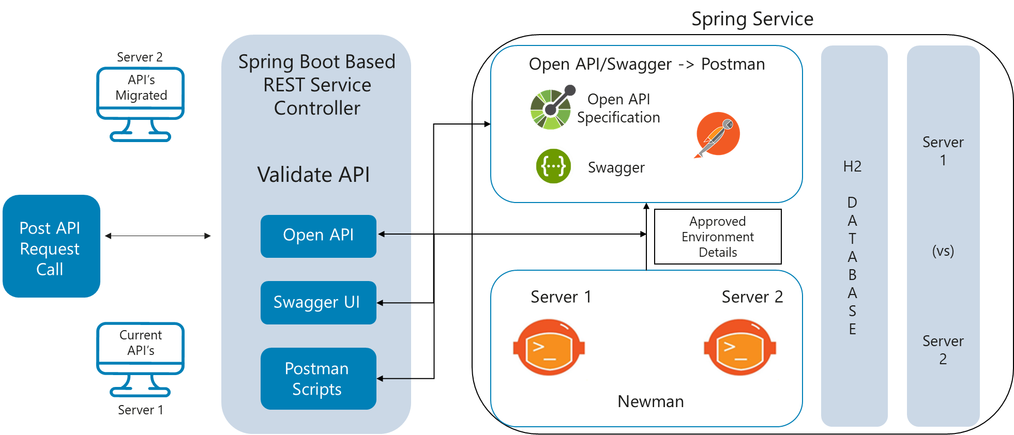
Intelliswift Accelerator - API Migration Test Feature Overview
API Migration Validator Features
Validates the API contract with respect to responses, status codes and schemas.
Business Rules Schema and Header Validation
Command Line Execution Support
CI/CD and Parallelism
Data Management Verification
Authentication & Orchestration
Reports and Dashboards
Supports multiple environments and protocols
Built in & custom Assertions; Supports HTTP request method, cookies, header
Token, Variable scope, chaining, Parameterization, Supports Path Extractors for XML & JSON

Slide 19





Partnership Overview
Next-Gen Threat Protection
Autonomous AI-powered Test Automation Platform
Real-time Threat Intelligence
Agentless, Continuous Protection
All-in-one proactive security
AI Blueprinting, Web Crawling
Functional tests, used as NFR scripts
100% user test automation coverage 0% maintenance
Continuous Orchestration Platform
enabling DevOps 2.0
API Management Platform
CI/CD Toolchain Automation
Declarative Pipelines
Unified Insights
API-First Integration with Apigee
Deployment flexibility
AI-powered API Monitoring
Manage microservices as APIs

